Slide 1

BRIGHTSPOTmovie production
Market entry proposal
September 2023

Slide 2
Key Findings: Strategic recommendations for higher ROI in Movie Production
What genres of movies to make?
Prioritize Budget for Mystery, Horror and Thriller movie genres
What is the optimal length of a successful movie?
Aim for a runtime between 108-120 minutes for the best chance at a high ROI. However, be open to notable exceptions, as outliers like movies with a length of 85 minutes or 134 minutes can also succeed.
How much budget is needed?
Invest mainly into $5-20 million range but also consider select <$5 million movies for potential high ROI and reduced risk

Slide 3
Data Sources Used:
Box Office Mojo
IMDB
Rotten Tomatoes
TheMovieDB
The Numbers
Limitations:
BRIGHTSPOT
Data lost through cleanup

Slide 4
What is a Successful Movie?
High Number of Votes > 1000
High Vote Rating > 7.0
The Return on Investment(ROI ) > 10%
BRIGHTSPOT

Slide 5
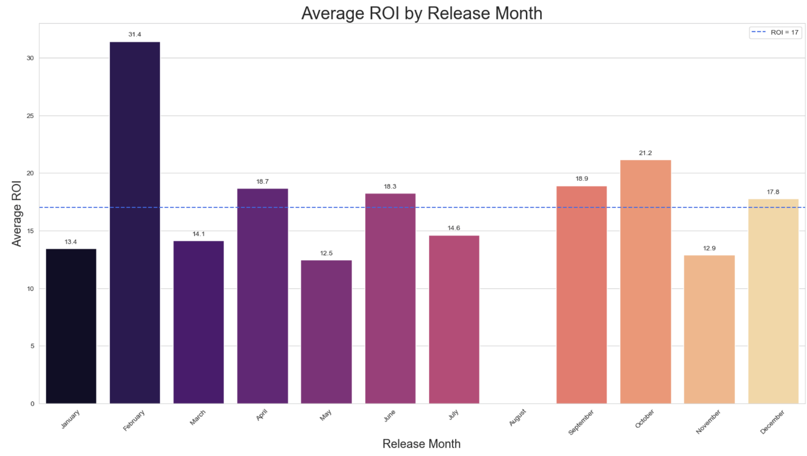
Optimal Release Windows for Higher Movie ROI:
Seasonal Implications:
February: Coincides with Valentine's Day.
April: Positioned between the spring break and the beginning of the summer blockbuster season.
June: Start of the summer blockbuster season.
October: Pre-holiday season and also a time for horror/thriller releases due to Halloween.
November: Thanksgiving holiday season in the U.S.
*

Slide 6
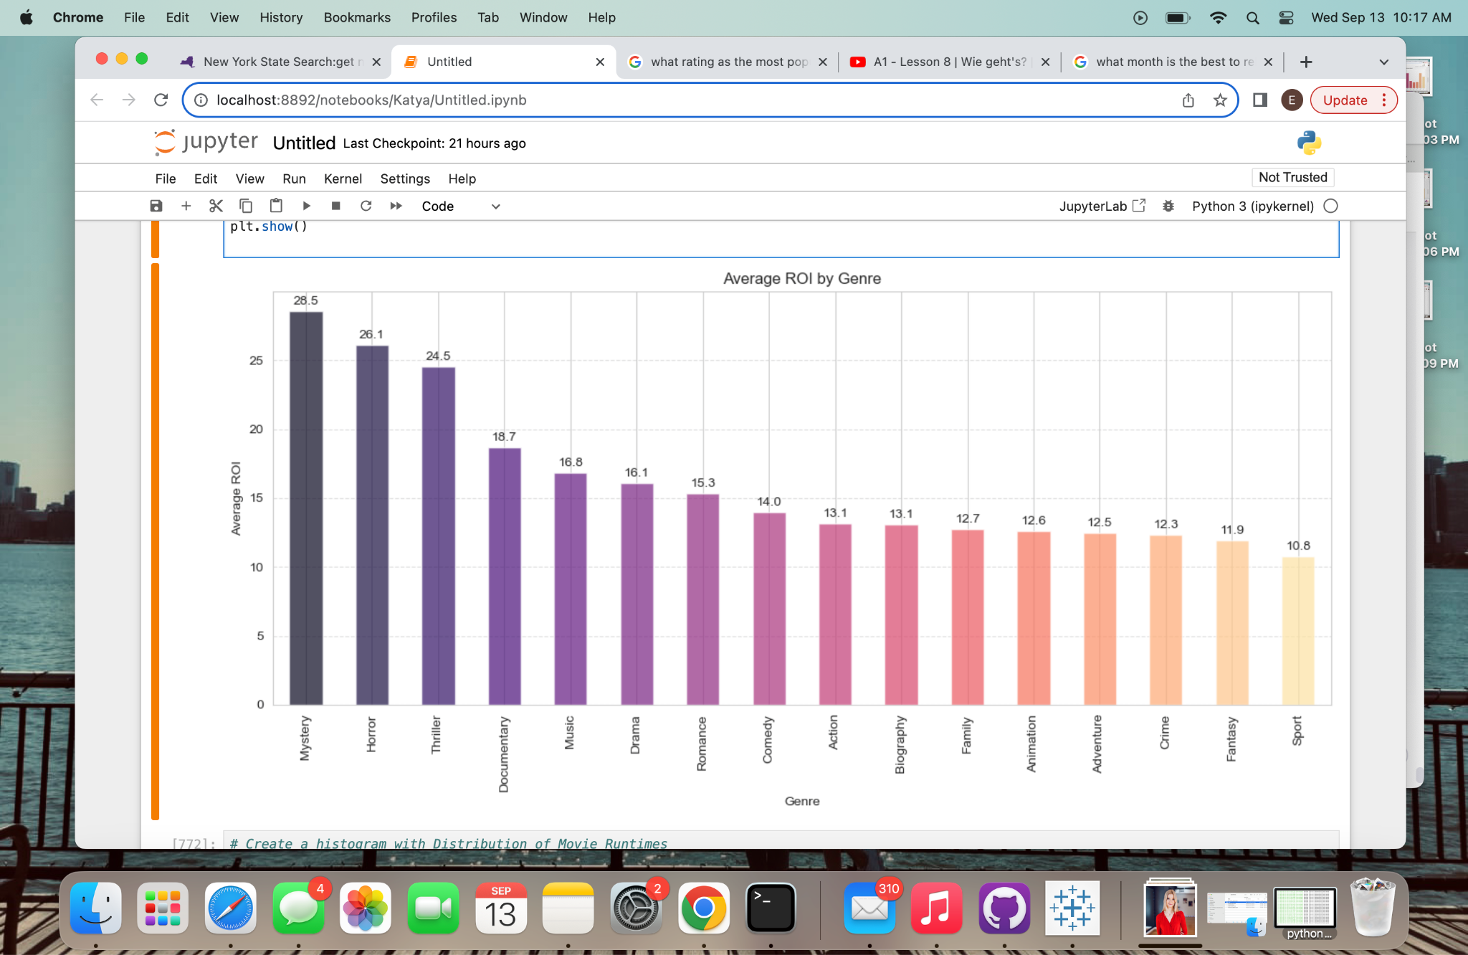
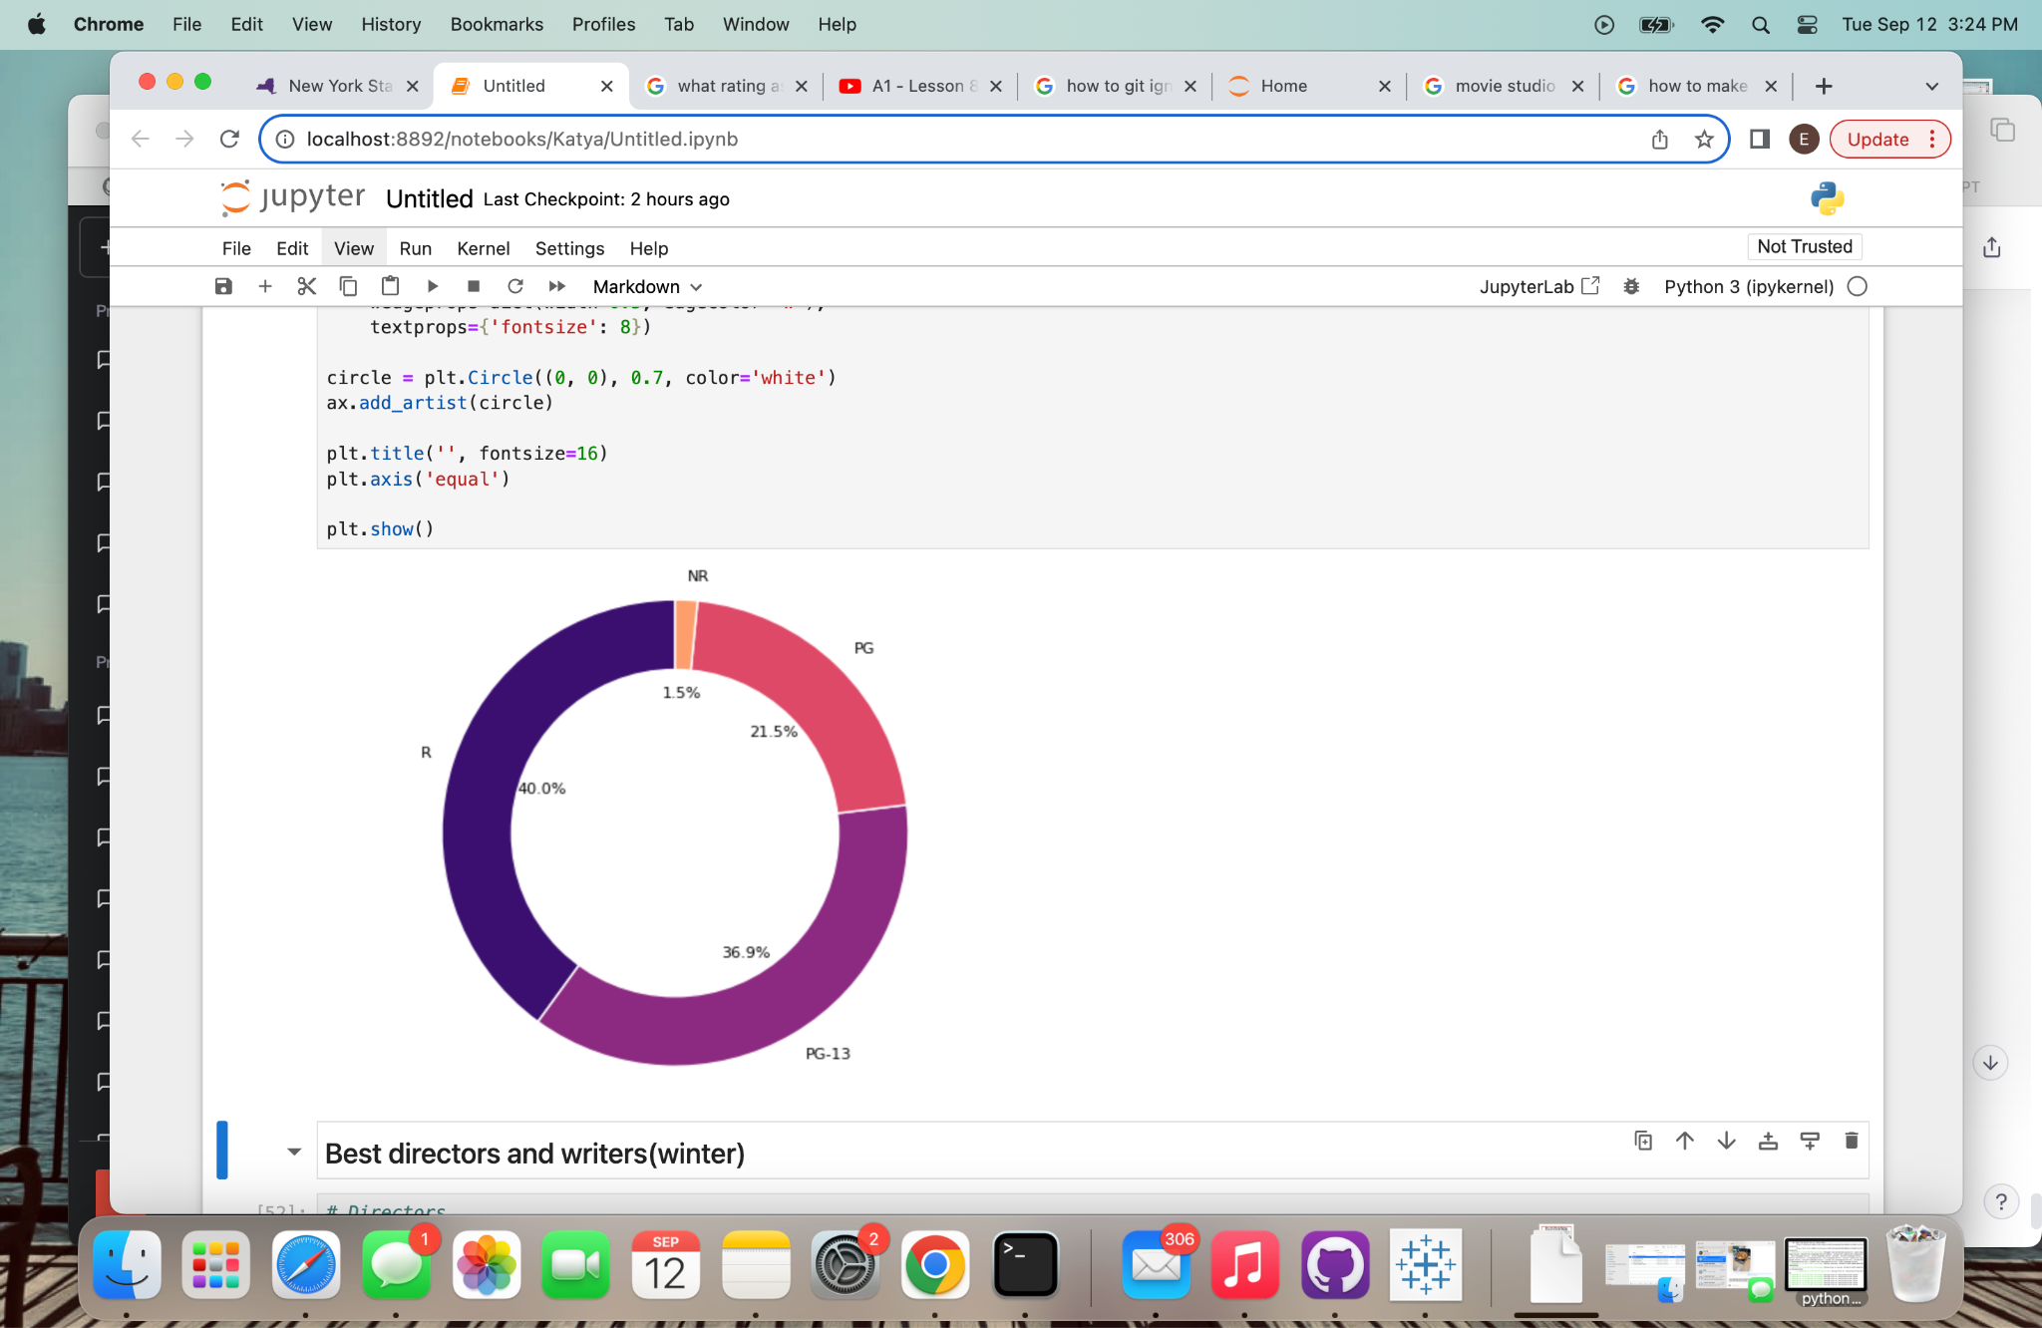
Distribution of Movie Genres in Winter/Summer
Distribution of Ratings in WInter/Summer
Movies with over 20% ROI typically have Mystery, Horror, Thriller genres
Lower production cost
Broad Appeal
Innovative Filmmaking
Viral Marketing
BRIGHTSPOT
Best formla for ROI movie

Slide 7
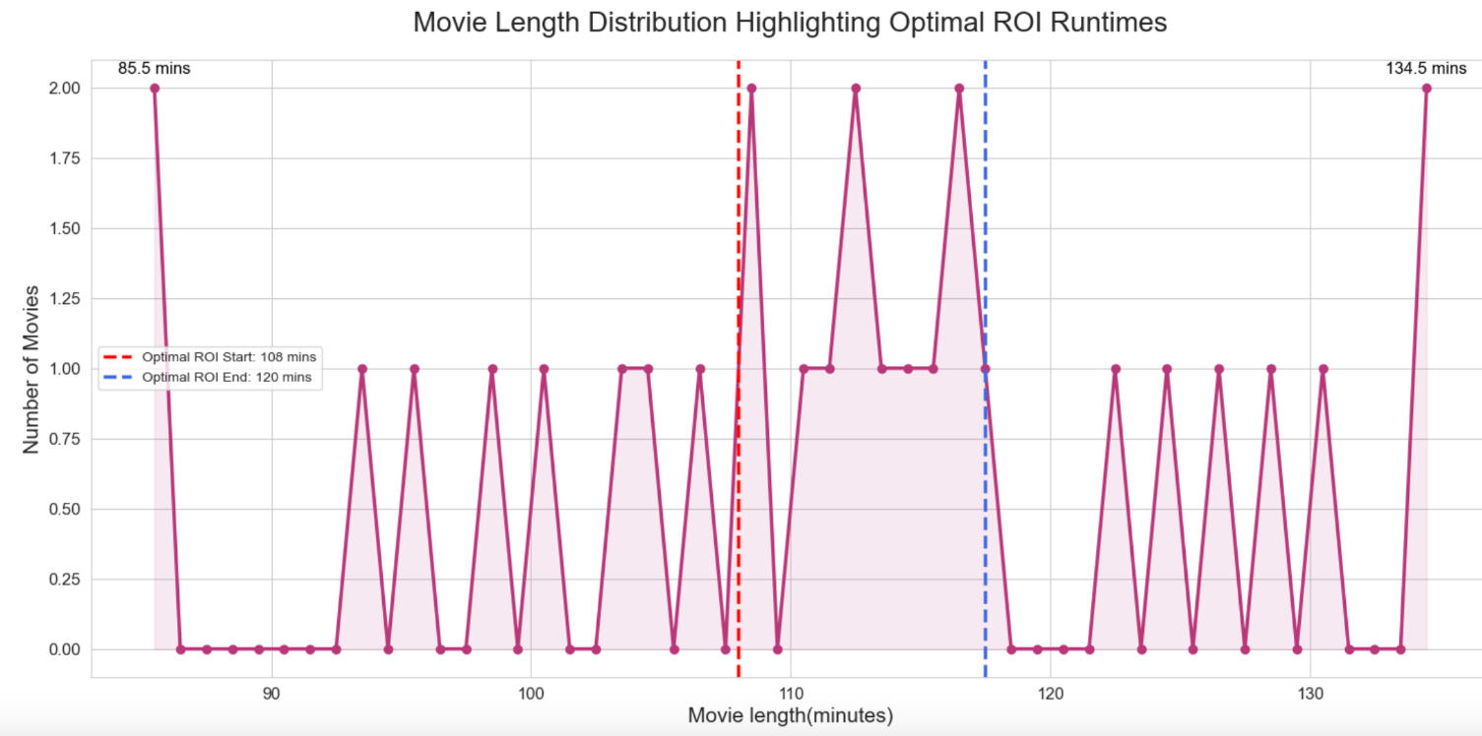
ROI Optimized Movie length should be 108-118 mins
Optimal movie length(108 - 118 min):
This duration aligns well with the average audiences attention span
From a financial perspective , a movie length in this range means more showings per day in the theater
Outliers:
Short films(85 min) often get attention in film festivals, which can boost their popularity and their return
Epic Fantasies, Historical Dramas and Complex Thrillers might require more time(135 min) to flesh out the story properly

Slide 8
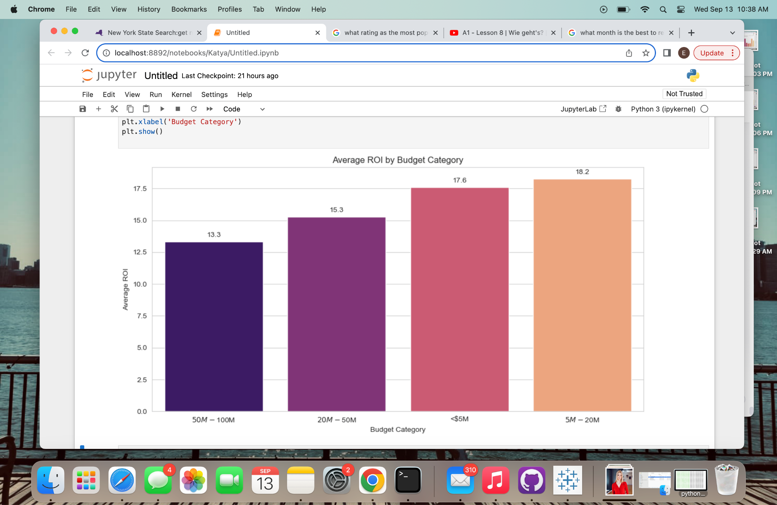
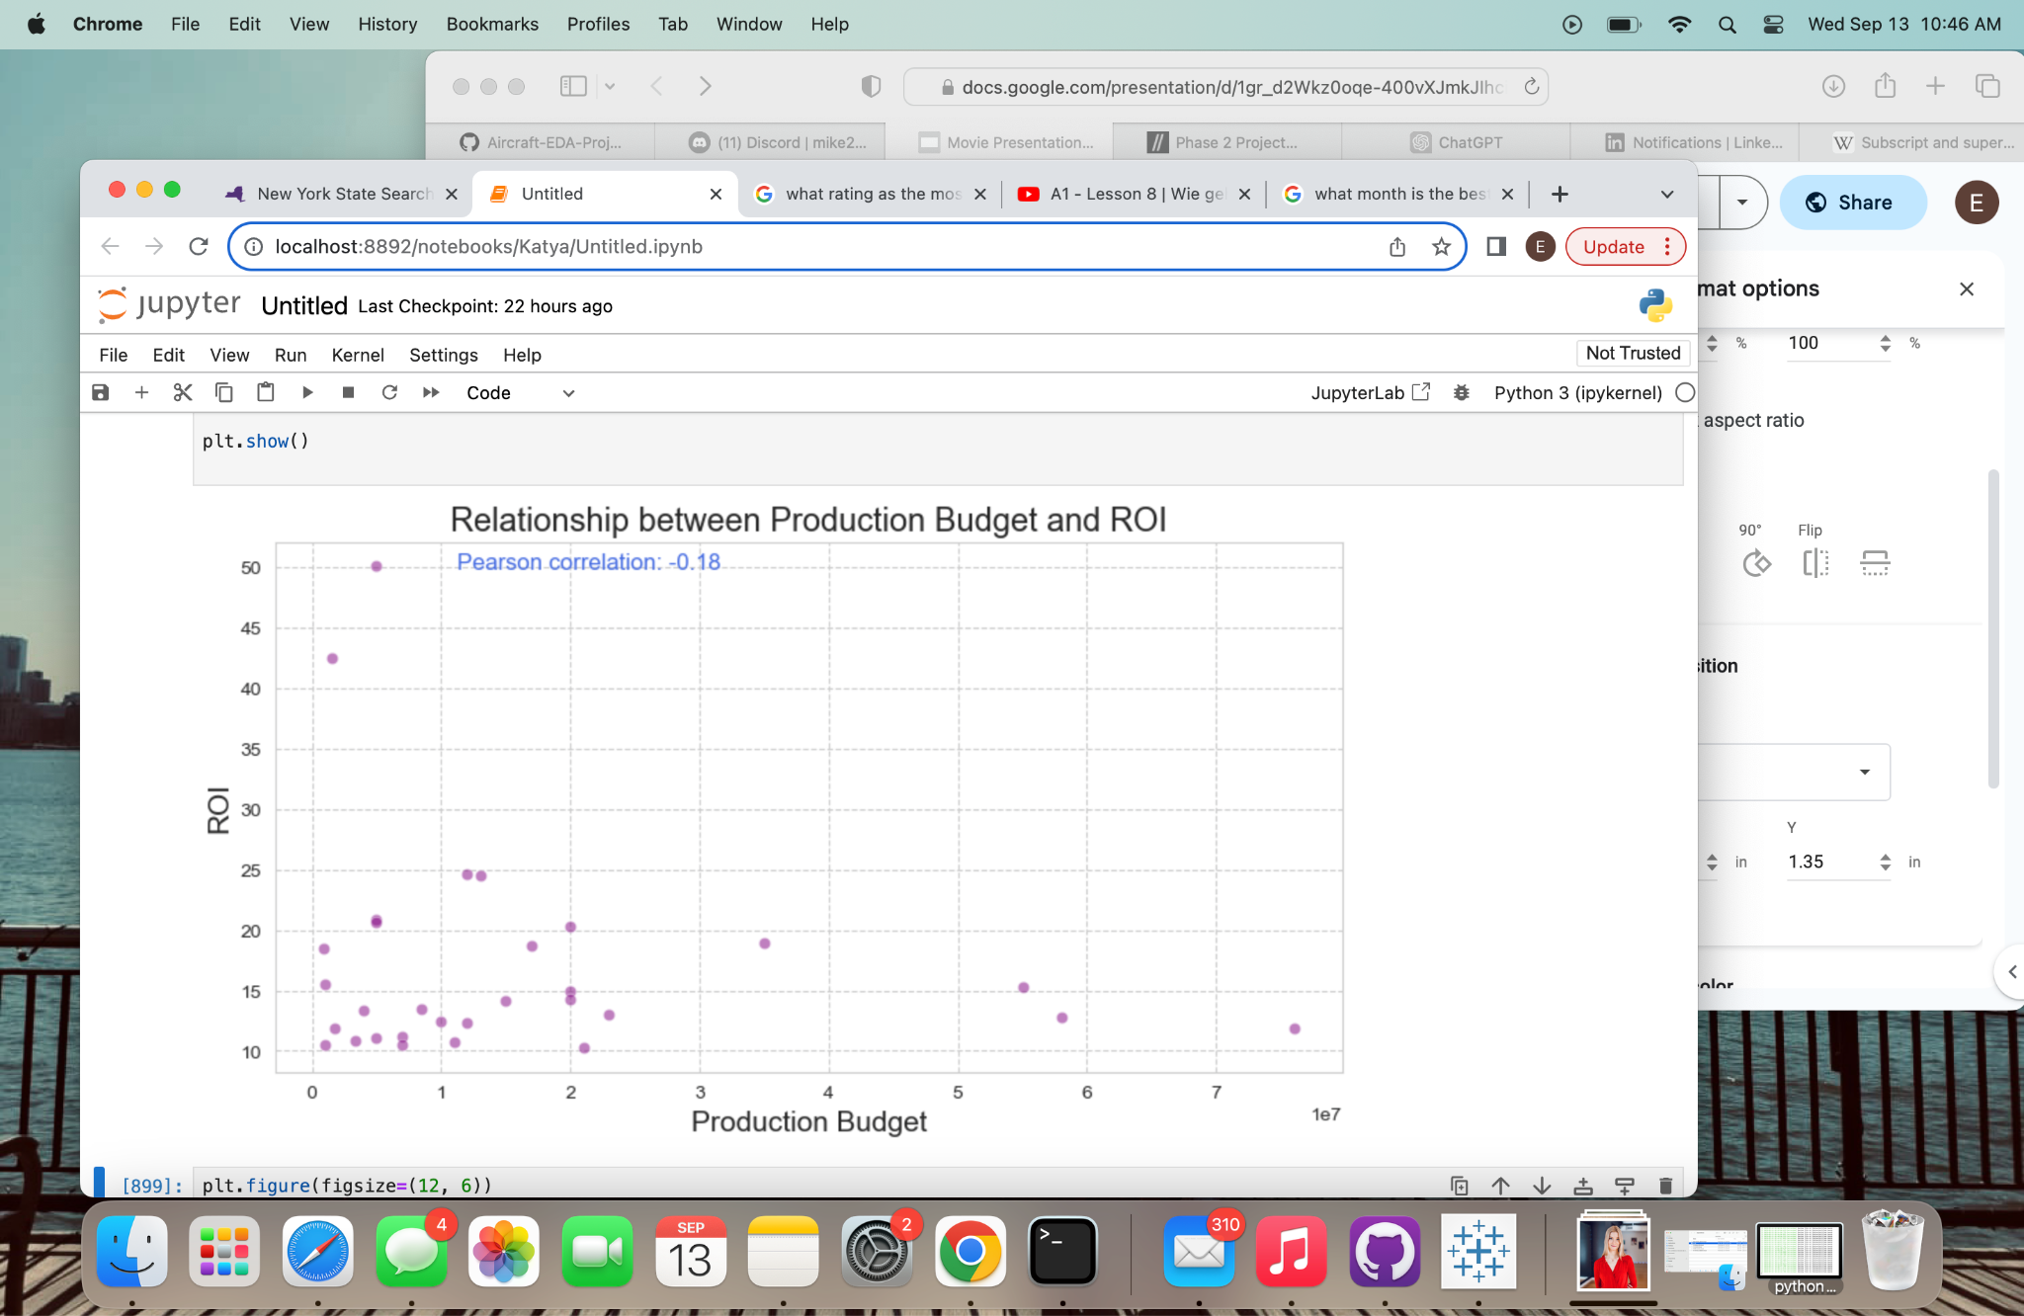
Movies with budgets in the range of $5 million to $20 million offer a higher ROI
While the $5-20 million range seems promising, it's also wise for a production company to have a diversified portfolio. Producing some lower-budget films (<$5 million) might result in surprise hits
The weak negative correlation suggests that increasing the production budgets does not necessarily guarantee a proportionally higher ROI

Slide 9
Further Research:
Need more up to date Data
Where are consumers watching movies? How have platforms like Netflix, Amazon Prime, Disney+, etc., influenced movie viewership trends and box office returns?
How do International markets compare to the domestic market in terms of popularity?
How does the marketing budget relate to ROI? Does a higher marketing spend guarantee higher ratings or more votes?
BRIGHTSPOT

Slide 10



Biographies
Ekaterina Serbina
Email: serbinaekaterina99@gmail.com
Github: https://github.com/serbinaekaterinai
LinkedIn: https://www.linkedin.com/in/ekaterina-serbina-48917228b/
Jacob Serfaty
Email: jacob.serfaty@gmail.com
Github: https://github.com/jacobserfaty
LinkedIn: https://www.linkedin.com/in/jacob-serfaty/
Michael Hammer
Email: michaelhammerb@gmail.com
Github: https://github.com/michaelhammer1
LinkedIn: https://www.linkedin.com/in/michaelhammerb/

